Slide 1
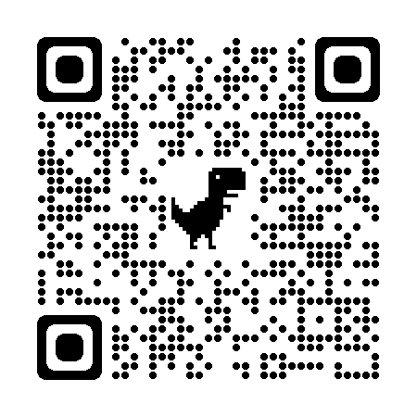
REFLECTIONS CALL FOR ENTRIES
Explore the arts and express yourself!
Reflections is a National PTA program where students can be artists and creators! Entrants should reflect on this year's theme “I am Hopeful Because…“ and create entries in the art categories of their choice:
Dance Choreography Film Production Visual Arts Photography Music Composition Literature
Deadline for entries is Wednesday, November 1st.
Please use QR Code to submit your entry!
Questions? Interested in judging or being part of the Reflections Committee? Email us at sangsterptareflections@gmail.com

